Slide 1
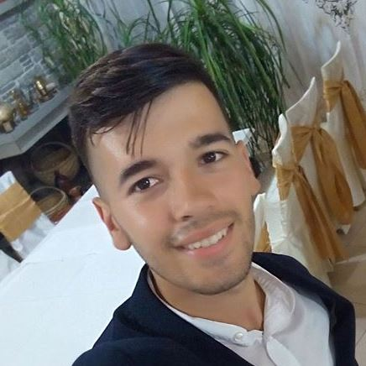


Albania
Juxhin Hamiti
ALJH

Slide 2
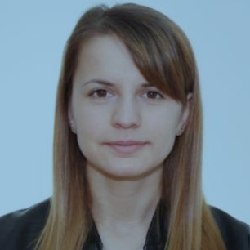
Albania
Lori Bodlli
ALLB

Slide 3
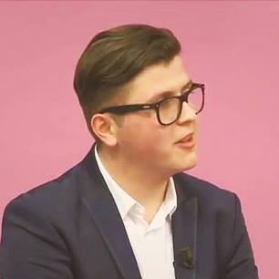
Albania
Igli Tola
ALIT

Slide 4
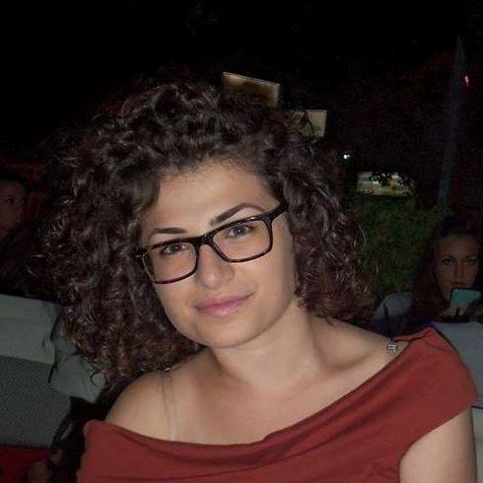
Albania
Ornela Shkurtaj
ALOS

Slide 5
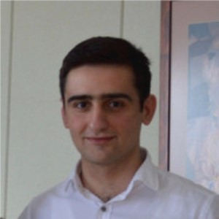

Armenia
Gor Mirzakhanyan
AMGM

Slide 6
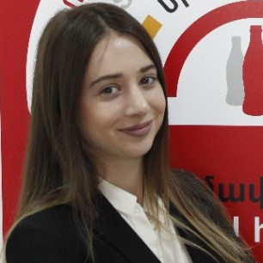
Armenia
Arpi Davtyan
AMAD

Slide 7
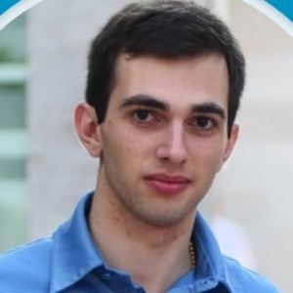
Armenia
Smbat Antaranyan
AMSA

Slide 8
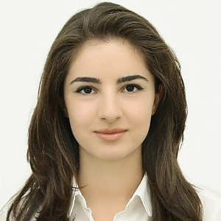
Armenia
Elen Ghevondyan
AMEG

Slide 9
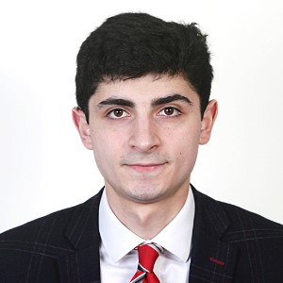

Armenia
Karen Badanyan
AMKB

Slide 10
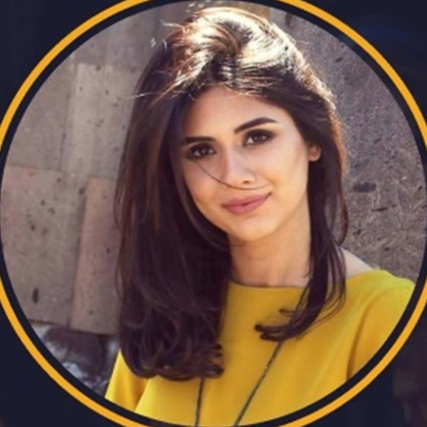
Armenia
Arpi Mikayelyan
AMAM

Slide 11
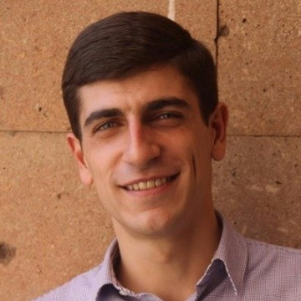
Armenia
Vladimir Prutyan
AMVP

Slide 12
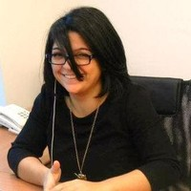
Armenia
Yeva Ter-Sahakyan
AMYT

Slide 13
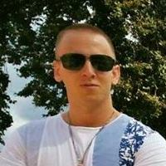

Austria
Tamás Kácsándi
ATTK

Slide 14
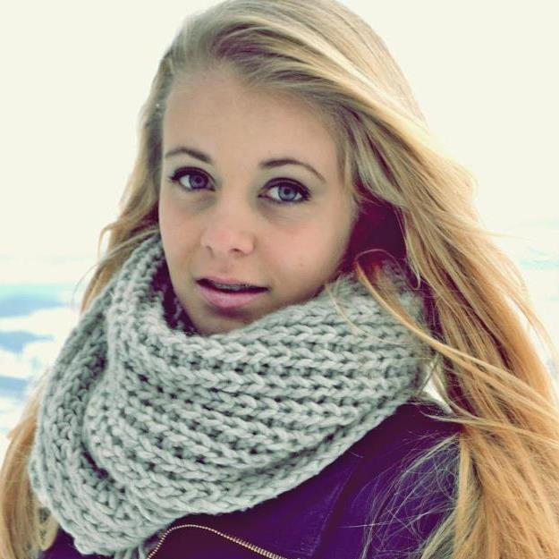
Austria
Hannah Kaltenegger
ATHK

Slide 15
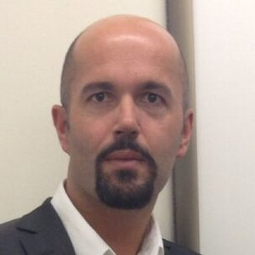
Austria
Thomas Kastenhofer
ATTK

Slide 16
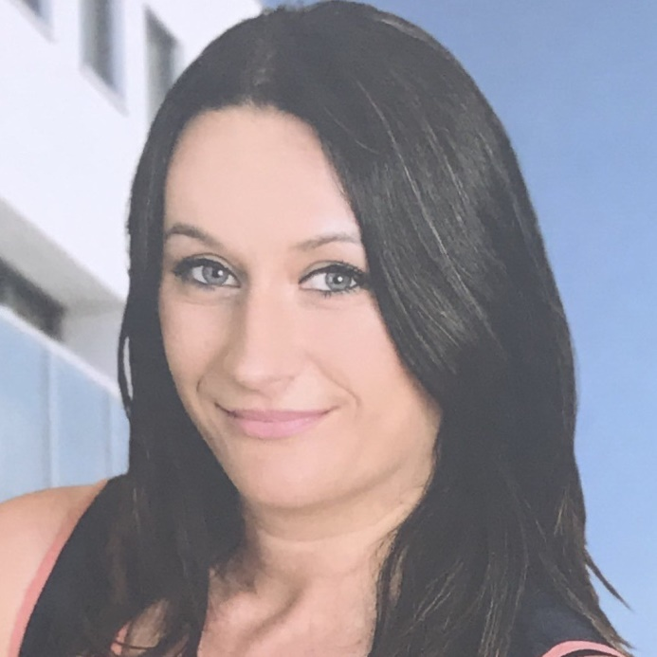
Austria
Verica Pesic
ATVP

Slide 17
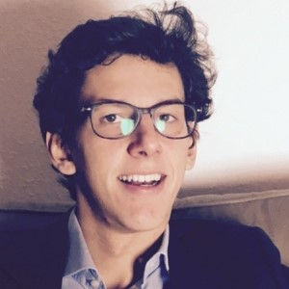

Belgium
Colomban Basset
BECB

Slide 18
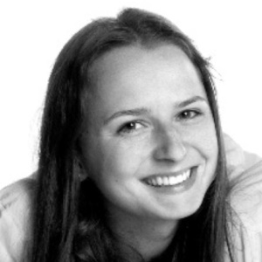
Belgium
Juliette Warzée
BEJW

Slide 19
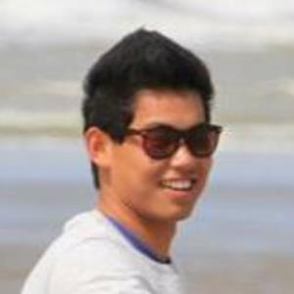
Belgium
Yifeng Yu
BEYY

Slide 20
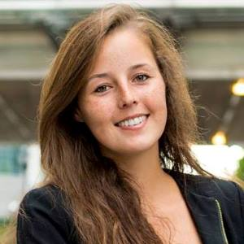
Belgium
Leila Zeimers
BELZ

Slide 21
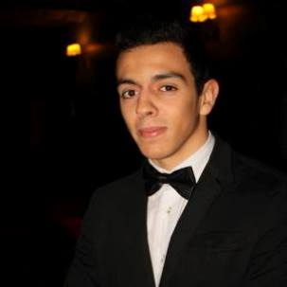

Belgium
Julien Ouali
BEJO

Slide 22
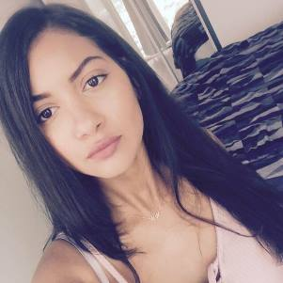
Belgium
Cécile Mutombo
BECM

Slide 23
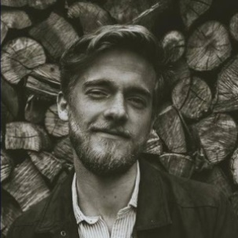
Belgium
Valentin Delaunoy
BEVD

Slide 24
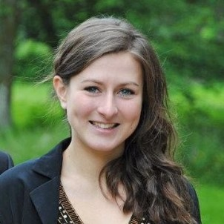
Belgium
Alisson Demanche
BEAD

Slide 25
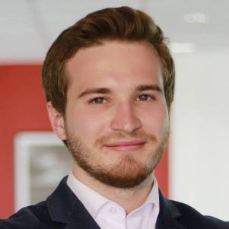

Bulgaria
Dmitry Bondarenko
BGDB

Slide 26

Bulgaria
Vladimira Mihaylova
BGVM

Slide 27
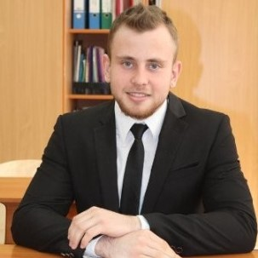
Bulgaria
Artem Kornev
BGAK

Slide 28
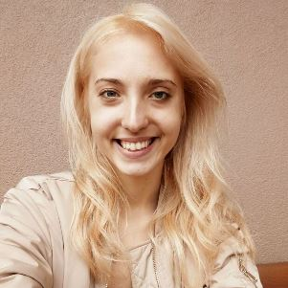
Bulgaria
Simona Zlatkova
BGSZ

Slide 29
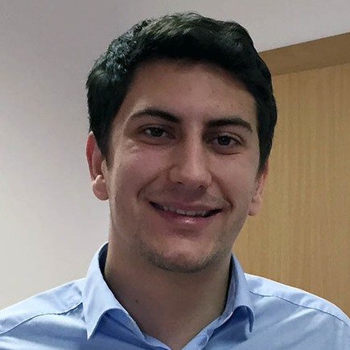

Croatia
Filip Špiranec
HRFS

Slide 30
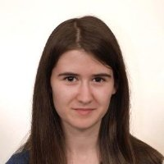
Croatia
Tea Logožar
HRTL

Slide 31
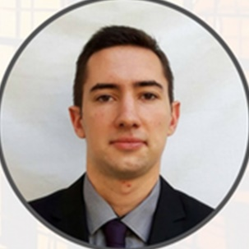
Croatia
Josip Halužan
HRJH

Slide 32
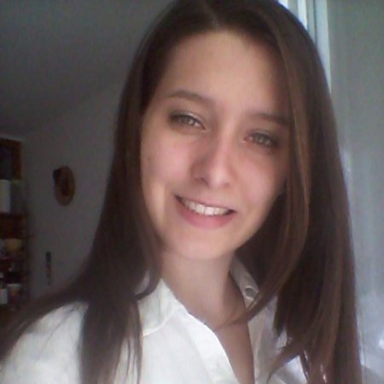
Croatia
Katarina Mitrović
HRKM

Slide 33
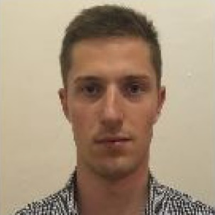

Czech Republic
Jiří Nosek
CZJN

Slide 34
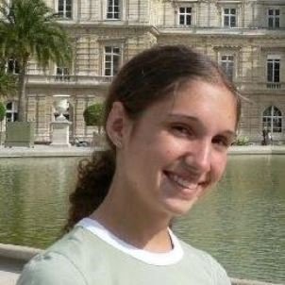
Czech Republic
Lucie Kraicová
CZLK

Slide 35
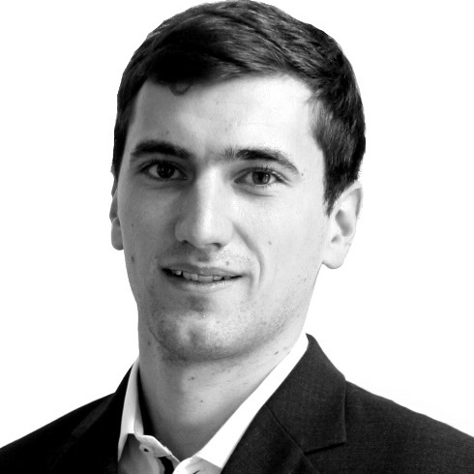
Czech Republic
Nicolas Fanta
CZNF

Slide 36
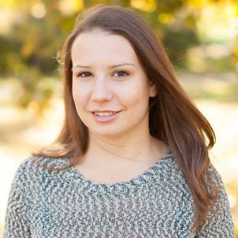
Czech Republic
Katarína Líšková
CZKL

Slide 37
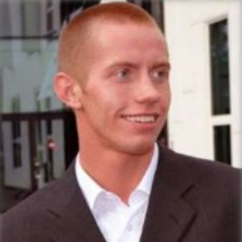

Estonia
Veiko Niinemäe
EEVN

Slide 38
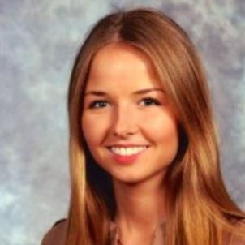
Estonia
Marleen Petermann
EEMP

Slide 39
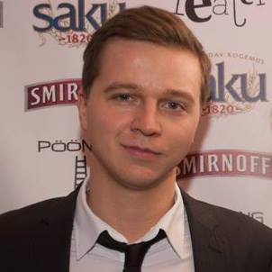
Estonia
Ruudi Lootus
EERL

Slide 40
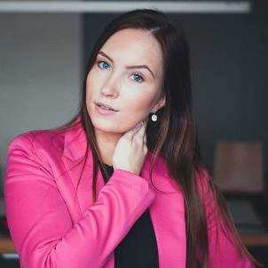
Estonia
Birgit Vilks
EEBV

Slide 41
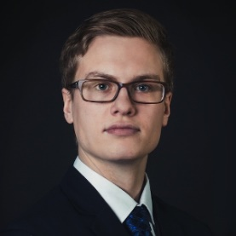

Finland
Paul Rintamäki
FIPR

Slide 42
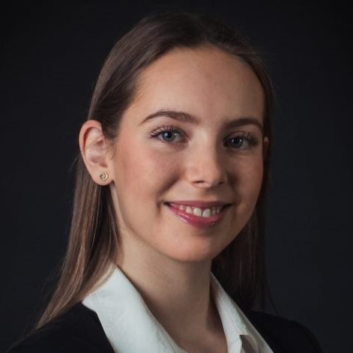
Finland
Stella Soirola
FIST

Slide 43
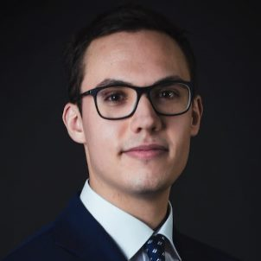
Finland
Sami Meha
FISM

Slide 44
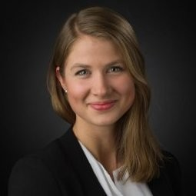
Finland
Minttu Bergendahl
FIMB

Slide 45
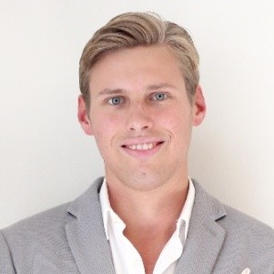

Finland
Vincent Weckström
FIVW

Slide 46
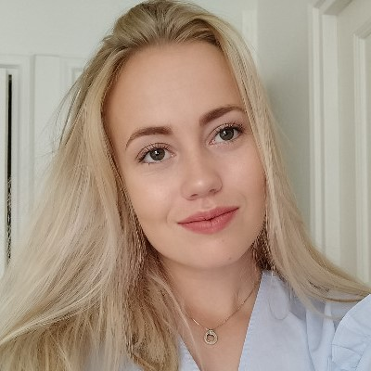
Finland
Rebecka Kjellman
FIRK

Slide 47
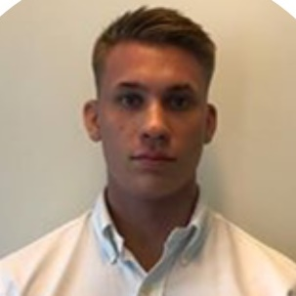
Finland
Felix Sandström
FIFS

Slide 48
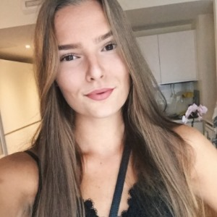
Finland
Emma Björkqvist
FIEB

Slide 49
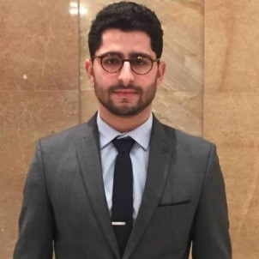

France
Jérémy Ganem
FRJG

Slide 50
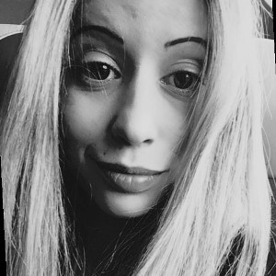
France
Camille Michaud
FRCM

Slide 51
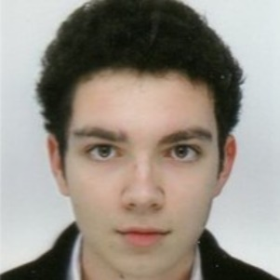
France
Samuel Rivière
FRSR

Slide 52

France
Feiyan Xu
FRFX

Slide 53


Germany
Yannik Isselhorst
DEYI

Slide 54

Germany
Karoline Bax
DEKB

Slide 55

Germany
Weibai Zhang
DEWZ

Slide 56

Germany
Johanna Maierhöfer
DEJM

Slide 57


Greece
Konstantinos Theodoridis
ELKT

Slide 58

Greece
Vasiliki Sankovits
ELVS

Slide 59

Greece
Themistoklis Hostelidis
ELTH

Slide 60

Greece
Evanthia Paradeisopoulou
ELEP

Slide 61


Greece
Anthony Efstathiadis
ELAE

Slide 62

Greece
Maria Alexopoulou
ELMA

Slide 63

Greece
Christos Ghikas
ELCG

Slide 64

Greece
Elisavet Ioannidou
ELEI

Slide 65


Hungary
Xian Chen
HUXC

Slide 66

Hungary
Kristina Simonyan
HUKS

Slide 67

Hungary
Kelemen Balazs
HUKB

Slide 68

Hungary
Katherine Yakimetz
HUKY

Slide 69


Ireland
Rory O’Callaghan
IERO

Slide 70

Ireland
Emma-Louise Ruane
IEER

Slide 71

Ireland
Andrew Johnson
IEAJ

Slide 72

Ireland
Portia Healy O'Connor
IEPH

Slide 73


Italy
Andrea Ferrario
ITAF

Slide 74

Italy
Iuliana Golub
ITIG

Slide 75

Italy
David Kalashnikov
ITDK

Slide 76

Italy
Laura Alb
ITLA

Slide 77


Italy
Ettore M. Ramerino
ITER

Slide 78

Italy
Diana Nuzzo
ITDN

Slide 79

Italy
Diego Palmari
ITDP

Slide 80

Italy
Vittoria Canale
ITVC

Slide 81


Kazakhstan
Akmaral Bolat
KZAB

Slide 82

Kazakhstan
Kamila Issakova
KZKI

Slide 83

Kazakhstan
Dinara Sadibekova
KZDS

Slide 84

Kazakhstan
Adel Zhumangarina
KZAZ

Slide 85


Latvia
Filip Drazdou
LVFD

Slide 86

Latvia
Dasha Labok
LVDL

Slide 87

Latvia
Artjoms Ogorodniks
LVAO

Slide 88

Latvia
Polina Sasinovich
LVPS

Slide 89


Lithuania
Kazimieras Pabiržis
LTKP

Slide 90

Lithuania
Laura Levulytė
LTLL

Slide 91

Lithuania
Artiom Rybakov
LTAR

Slide 92

Lithuania
Dovilė Baubkutė
LTDB

Slide 93


Luxembourg
Mehmet Emin Kurucu
LUME

Slide 94

Luxembourg
Lorena Alizoti
LULA

Slide 95

Luxembourg
Nikita Gaponiuk
LUNG

Slide 96

Luxembourg
Arjana Gjeta
LUAG

Slide 97


Macedonia (fyrom)
Marjan Dimov
MKMD

Slide 98

Macedonia (fyrom)
Ivana Arapova
MKIA

Slide 99

Macedonia (fyrom)
Vladimir Richliev
MKVR

Slide 100

Macedonia (fyrom)
Elena Arsova
MKEA

Slide 101


Malta
Steven Galea Pace
MTST

Slide 102

Malta
Martina Camilleri
MTMC

Slide 103

Malta
Andrew Cutajar
MTAC

Slide 104

Malta
Karen Gafa'
MTKG

Slide 105


Netherlands
Seungki Kim
NLSK

Slide 106

Netherlands
Maria Teplyakova
NLMT

Slide 107

Netherlands
Udit Kamal Parihar
NLUK

Slide 108

Netherlands
Sonali Chaurasia
NLSC

Slide 109


Netherlands
Sebastiaan Bredenbeek
NLSB

Slide 110

Netherlands
Kirby Tuls
NLKT

Slide 111

Netherlands
Vladimir Danila
NLVD

Slide 112

Netherlands
Mayke Hoynck van Papendrecht
NLMH

Slide 113


Norway
Marius Skyrud Harsjøen
NOMS

Slide 114

Norway
Aiza Aidekova
NOAA

Slide 115

Norway
Gaute Hellerslia
NOGH

Slide 116

Norway
Minja Rankov
NOMR

Slide 117


Poland
Przemysław Ryś
PLPR

Slide 118

Poland
Katarzyna Kryńska
PLKK

Slide 119

Poland
Kamil Mazur
PLKM

Slide 120

Poland
Marta Małek
PLMM

Slide 121


Poland
Tomasz Weron
PLTW

Slide 122

Poland
Katarzyna Hubicka
PLKH

Slide 123

Poland
Tomasz Serafin
PLTS

Slide 124

Poland
Alicja Weronika Kaszuba
PLAW

Slide 125


Russia
Eduard Khamidullin
RUEK

Slide 126

Russia
Anna Sevostianova
RUAS

Slide 127

Russia
Artem Pokhmelnykh
RUAP

Slide 128

Russia
Iuliia Mitrofanova
RUIM

Slide 129


Russia
Maxim Burobin
RUMB

Slide 130

Russia
Julia Karpushenkova
RUJK

Slide 131

Russia
Anatoly Mukhin
RUAM

Slide 132

Russia
Maria Lepikhina
RUML

Slide 133


Slovakia
Rudolf Bruchánik
SKRB

Slide 134

Slovakia
Alena Zemanová
SKAZ

Slide 135

Slovakia
Juraj Dedinský
SKJD

Slide 136

Slovakia
Alžbeta Bolešová
SKAB

Slide 137


Slovenia
Tim Lep
SITL

Slide 138

Slovenia
Nika Drobnič
SIND

Slide 139

Slovenia
Aleksander Bobič
SIAB

Slide 140

Slovenia
Marina Karnelutti
SIMK

Slide 141


Spain
Dimas Cuevas Izaguirre
ESDC

Slide 142

Spain
Nicole S. Gómez
ESNS

Slide 143

Spain
Juan Freire Rivera
ESJF

Slide 144

Spain
María del Mar Lozano Blázquez
ESMD

Slide 145


Sweden
Rafi Khaliqi
SERK

Slide 146

Sweden
Malin Andersen
SEMA

Slide 147

Sweden
Alp Yilmaz Berk
SEAY

Slide 148

Sweden
Lana Awawt Rahim
SELA

Slide 149


Switzerland
Kanan Mammadzada
CHKM

Slide 150

Switzerland
Wenni Lin
CHWL

Slide 151

Switzerland
Simone Cera
CHSC

Slide 152

Switzerland
Petra Bernasconi
CHPB

Slide 153


United Kingdom
Oliver Pearn
UKOP

Slide 154

United Kingdom
Victoria Collins
UKVC

Slide 155

United Kingdom
Rinto Fujimoto
UKRF

Slide 156

United Kingdom
Carys Isabel Santamaria Fox
UKCI

