Slide 1
KAZAKHSTAN
Astana => Rome: Km. 4,505

Slide 2


Slide 3
ARMENIA
Jerevan => Rome: Km. 2,678

Slide 4


Slide 5


Slide 6
RUSSIA
Moscow => Rome: Km. 2,378

Slide 7


Slide 8


Slide 9
FINLAND
Helsinki => Rome: Km. 2,204

Slide 10


Slide 11


Slide 12
ESTONIA
Tallinn => Rome: Km. 2,127

Slide 13


Slide 14
NORWAY
Oslo => Rome: Km. 2,009

Slide 15


Slide 16
SWEDEN
Stockholm => Rome: Km. 1,978

Slide 17


Slide 18
IRELAND
Dublin => Rome: Km. 1,888

Slide 19


Slide 20
LATVIA
Riga => Rome: Km. 1,868

Slide 21
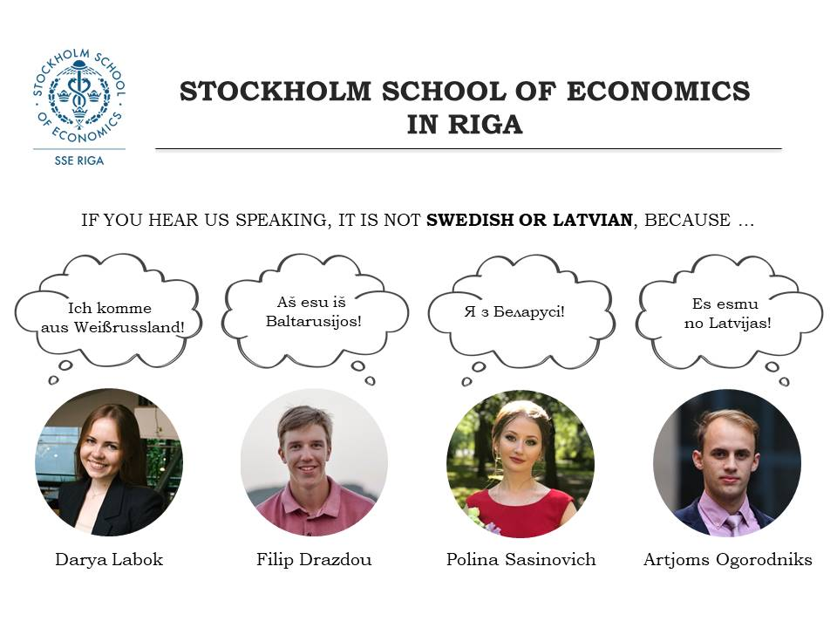

Slide 22
LITHUANIA
Vilnius => Rome: Km. 1,703

Slide 23


Slide 24
UNITED KINGDOM
London => Rome: Km. 1,435

Slide 25


Slide 26
SPAIN
Madrid => Rome: Km. 1,366

Slide 27


Slide 28
POLAND
Warsaw => Rome: Km. 1,316

Slide 29


Slide 30


Slide 31
NETHERLANDS
Amsterdam => Rome: Km. 1,298

Slide 32


Slide 33


Slide 34
GERMANY
Berlin => Rome: Km. 1,184

Slide 35


Slide 36
BELGIUM
Bruxelles => Rome: Km. 1,175

Slide 37


Slide 38


Slide 39
FRANCE
Paris => Rome: Km. 1,107

Slide 40


Slide 41
GREECE
Athens => Rome: Km. 1,052

Slide 42


Slide 43


Slide 44
LUXEMBOURG
Luxembourg => Rome: Km. 989

Slide 45


Slide 46
CZECHIA
Prague => Rome: Km. 922

Slide 47


Slide 48
BULGARIA
Sophia => Rome: Km. 895

Slide 49


Slide 50
HUNGARY
Budapest => Rome: Km. 809

Slide 51


Slide 52
SLOVAKIA
Bratislava => Rome: Km. 784

Slide 53


Slide 54
AUSTRIA
Wien => Rome: Km. 765

Slide 55


Slide 56
MACEDONIA
Skopje => Rome: Km. 739

Slide 57


Slide 58
MALTA
La Valletta => Rome: Km. 691

Slide 59


Slide 60
SWITZERLAND
Bern => Rome: Km. 690

Slide 61


Slide 62
ALBANIA
Tirana => Rome: Km. 613

Slide 63


Slide 64
CROATIA
Zagreb => Rome: Km. 518

Slide 65


Slide 66
SLOVENIA
Ljubljana => Rome: Km. 490

Slide 67


Slide 68
ITALY
Rome => Rome: Km. 0,000

Slide 69


Slide 70


